Slide 1
Machine Learning
Machine Learning Introduction to Machine Learning by Kumar Anurupam is licensed under a Creative Commons Attribution-4.0 International License.
Hypothesis testing and Z test
CS 3104 Fall 2019
Lecture Slides by Kumar Anurupam
Slides taken from the video “Statistics 101” by Brandon Foltz

Slide 2
Learning Objectives
After completion of today’s session you will be able to:
Describe the procedure of hypothesis testing.
Explain the concept of z - test

Slide 3
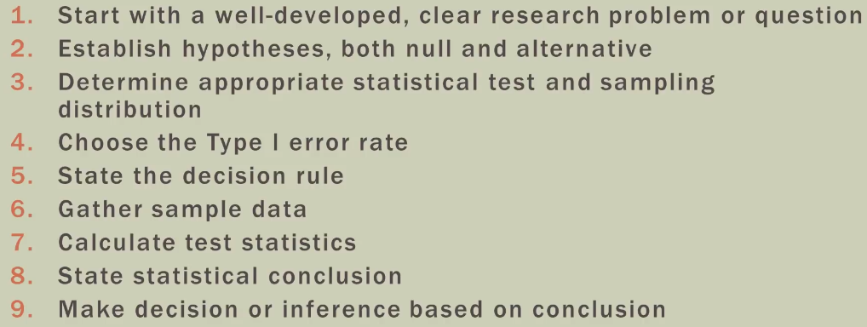
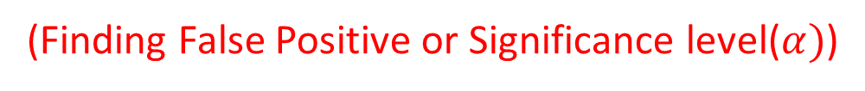
Hypothesis testing procedure
(Finding False Positive or Significance level($α)$)

Slide 4
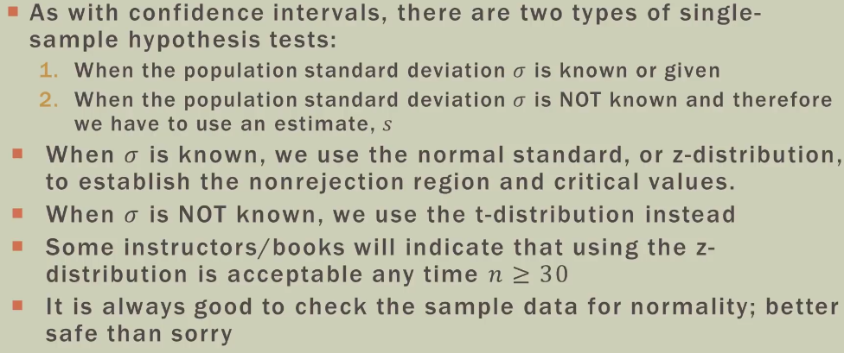
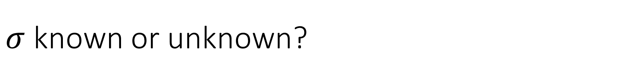
$σ$ known or unknown?

Slide 5
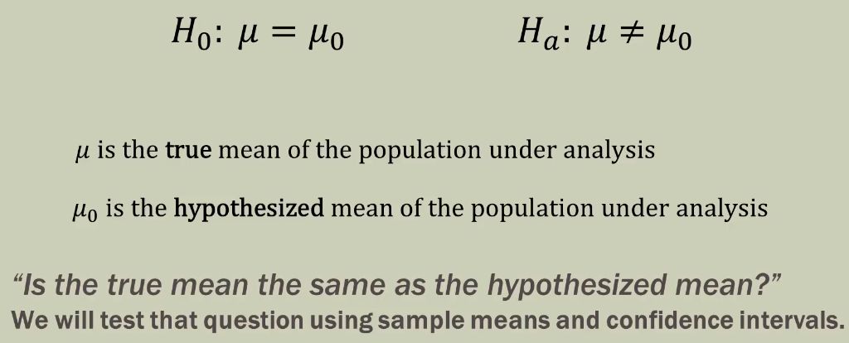
Hypothesized VS True Mean

Slide 6
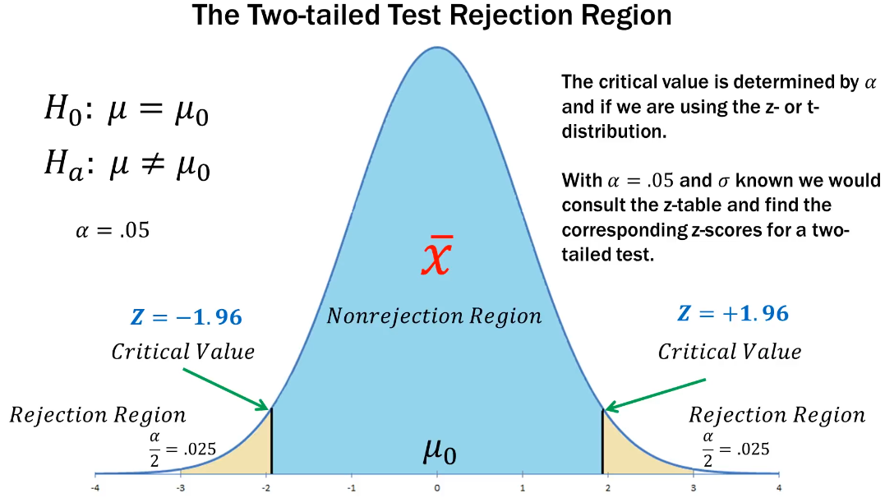

Slide 7
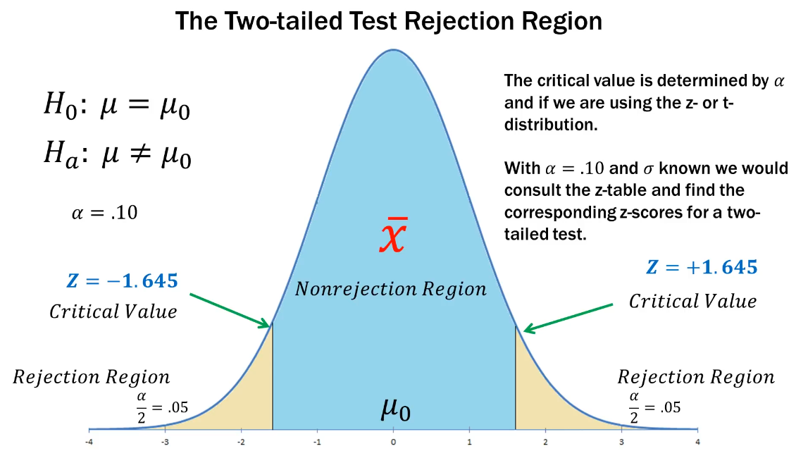

Slide 8
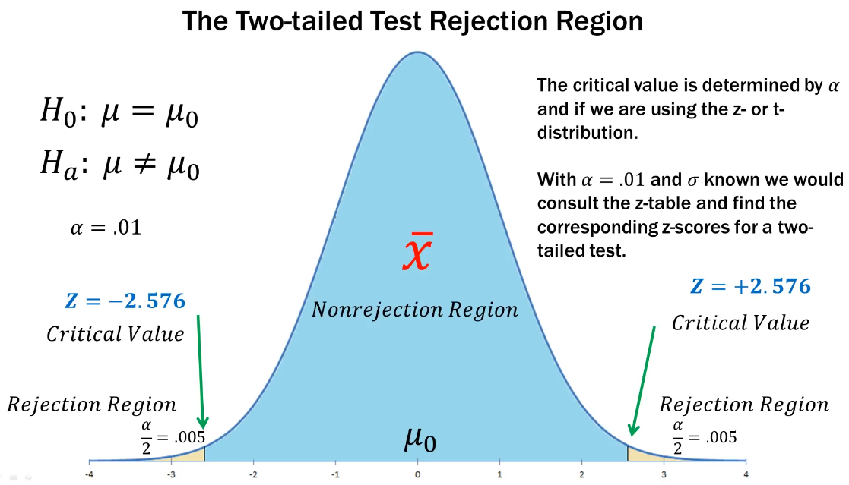

Slide 9
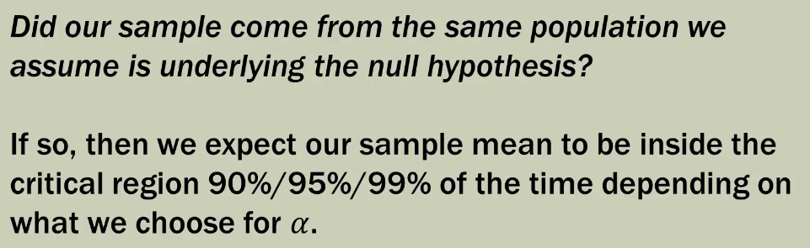
What are we really asking?

Slide 10
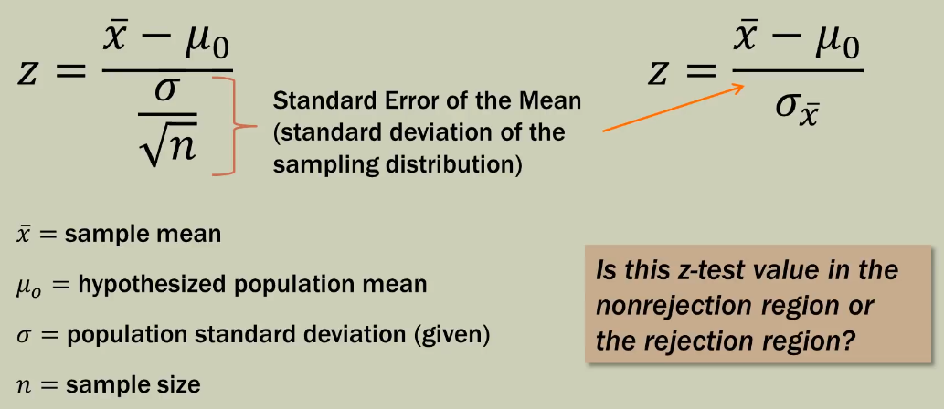
Z – test for a single mean

Slide 12
Thanks

